Slide 1

Improving Implicit Recommender Systems with View Data
Jingtao Ding¹, Guanghui Yu¹, Xiangnan He², Yuhan Quan¹, Yong Li¹,
Tat-Seng Chua², Depeng Jin¹, Jiajie Yu³
¹ Tsinghua University ² National University of Singapore ³ Beibei Inc

Slide 2
Motivation
Implicit Feedback
e.g. purchases, clicks, watches, …
Aims at recommending (unconsumed) items to users.
Natural scarcity of negative signal
Unobserved missing data (0 entries) is important!
Handling missing data with Matrix Factorization (MF) methods
1. sampling partial missing data
2. modeling the whole data
Unobserved interactions
items
0 | 1 | 0 | 0
1 | 1 | 0 | 0
0 | 0 | 0 | 1
0 | 0 | 1 | 0
users
0/1 Interaction matrix

Slide 3
Motivation
Multiple types of user feedback data
Primary feedback
directly related with business KPI
Auxiliary user feedback data available
E-commerce:
users’ views on products (i.e., click the product page)
E-commerce
Online-Ads

Slide 4
Motivation
I viewed this because it’s interesting to me.
Twofold semantics
Positive signal
Not good enough for me to buy it!
Viewing behavior in
E-commerce websites
Negative signal
Our Target
Implicit MF
View data as an intermediate feedback

Slide 5
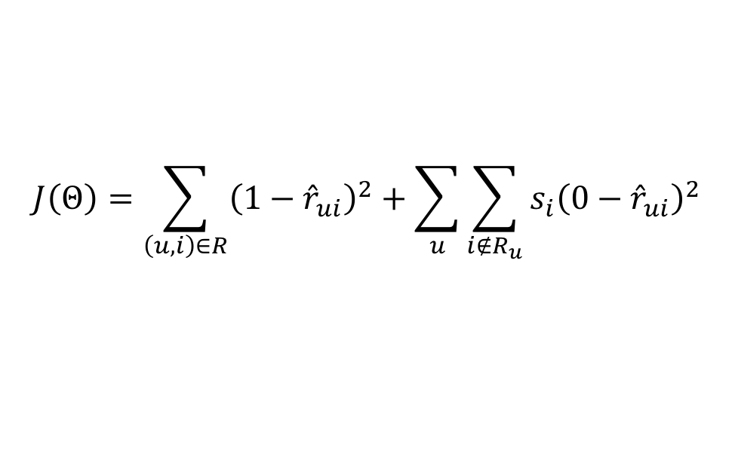
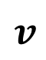
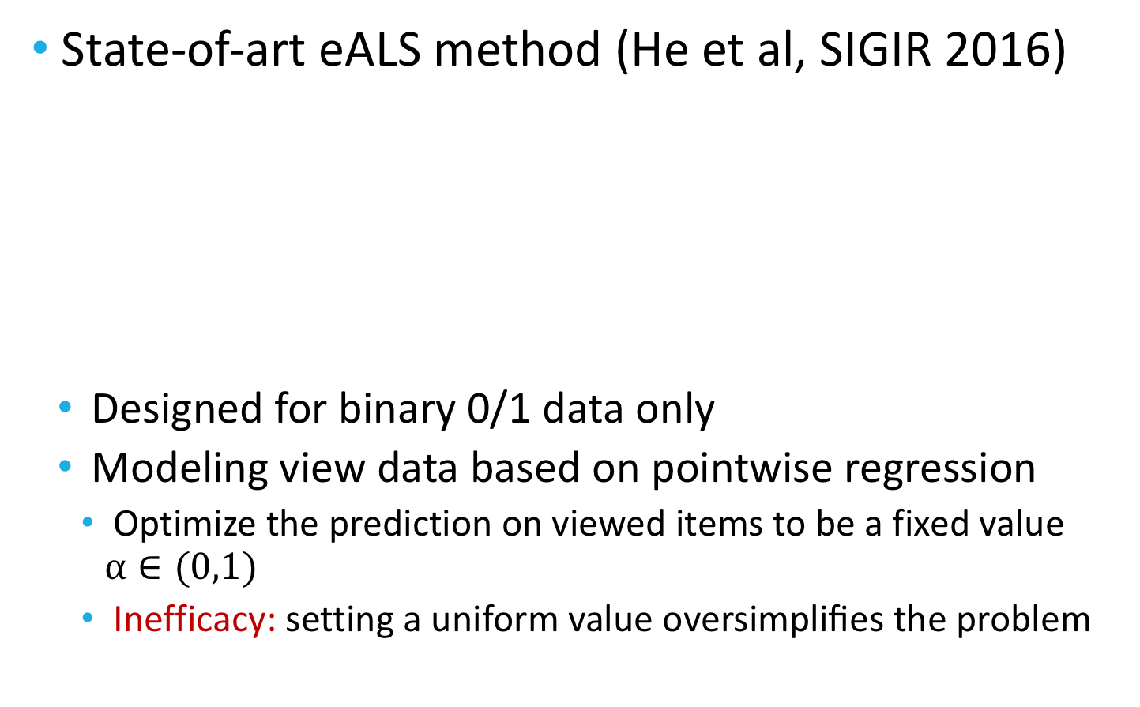
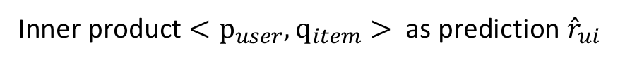
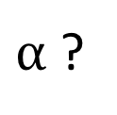
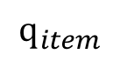

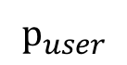
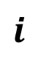
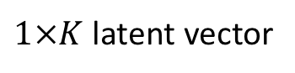
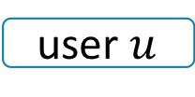
Difficulty of Modeling View Data
State-of-art eALS method (He et al, SIGIR 2016)
Designed for binary 0/1 data only
Modeling view data based on pointwise regression
Optimize the prediction on viewed items to be a fixed value $α∈(0,1)$
Inefficacy: setting a uniform value oversimpliﬁes the problem
items
label
A lower weight
$$i$$
1
$1×K$ latent vector
$$J\left(Θ\right)=\sum_{\left(u,i\right)∈R}{{\left(1−{\hat{r}}_{ui}\right)}^{2}}+\sum_{u}{\sum_{i∉R_{u}}{{s_{i}\left(0−{\hat{r}}_{ui}\right)}^{2}}}$$
$$p_{user}$$
purchase
Inner product $<p_{user},q_{item}>$ as prediction ${\hat{r}}_{ui}$
$$q_{item}$$
view
$v$
$α$ ?
Prediction on users’ purchased (i.e., observed ) items
Prediction on unobserved interactions
user $u$
not interact
…
0
$$j$$

Slide 6
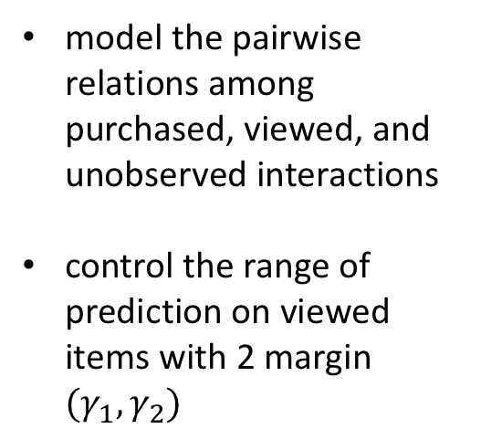
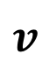
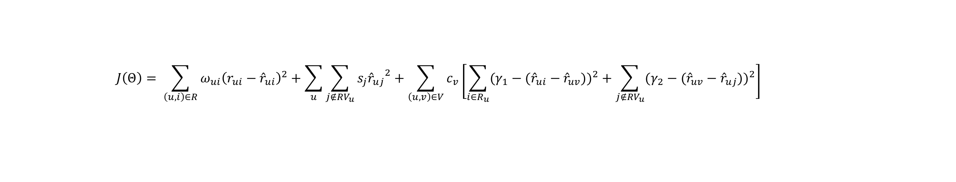
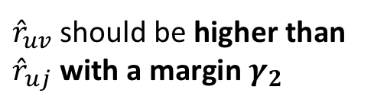

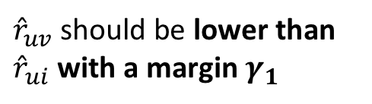

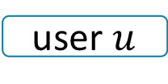
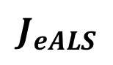
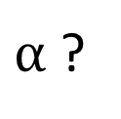
Solution -- View-enhanced Objective Function
$$J_{eALS}$$
$$J_{view}$$
$$J\left(Θ\right)= \sum_{\left(u,i\right)∈R}{ω_{ui}{\left(r_{ui}−{\hat{r}}_{ui}\right)}^{2}+\sum_{u}{\sum_{j∉{RV}_{u}}{s_{j}{{\hat{r}}_{uj}}^{2}}}}+\sum_{\left(u,v\right)∈V}{c_{v}}\left[\sum_{i∈R_{u}}{{(γ_{1}−({\hat{r}}_{ui}−{\hat{r}}_{uv}))}^{2}}+\sum_{j∉{RV}_{u}}{{(γ_{2}−({\hat{r}}_{uv}−{\hat{r}}_{uj}))}^{2}}\right]$$
items
label
model the pairwise relations among purchased, viewed, and unobserved interactions
control the range of prediction on viewed items with 2 margin ${(γ}_{1},γ_{2})$
$$i$$
1
${\hat{r}}_{uv}$should be lower than ${\hat{r}}_{ui}$with a margin $γ_{1}$
purchase
view
$$v$$
$α$ ?
user $u$
${\hat{r}}_{uv}$should be higher than ${\hat{r}}_{uj}$with a margin $γ_{2}$
not interact
…
0
$$j$$

Slide 7
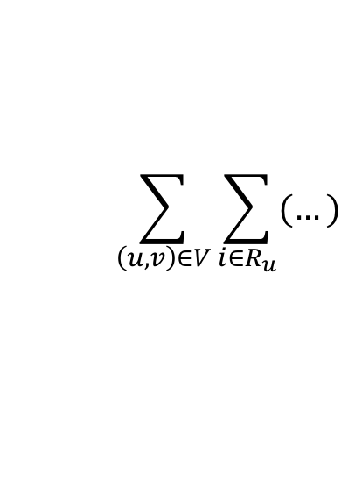
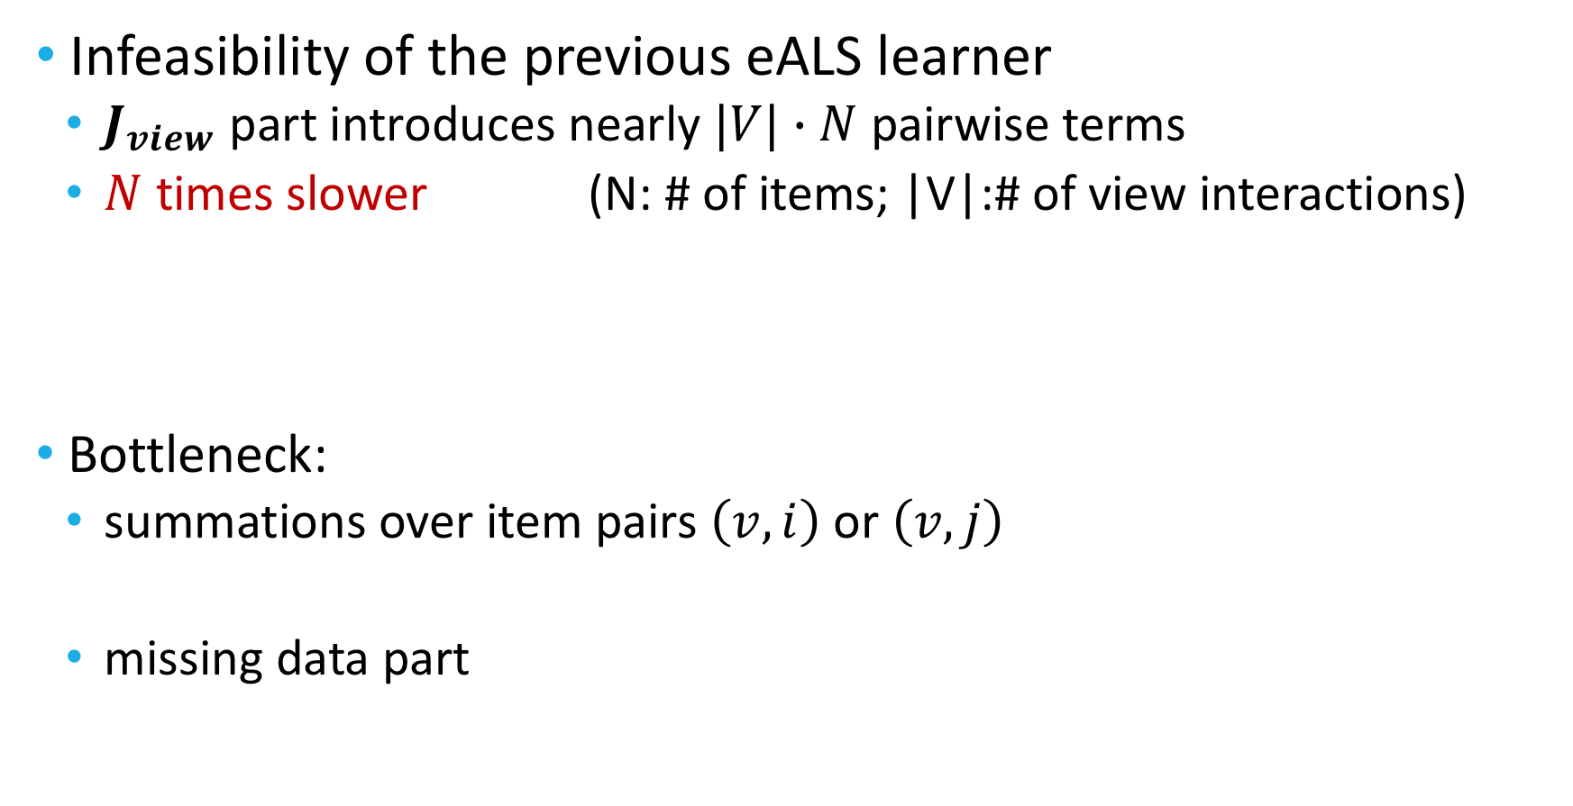
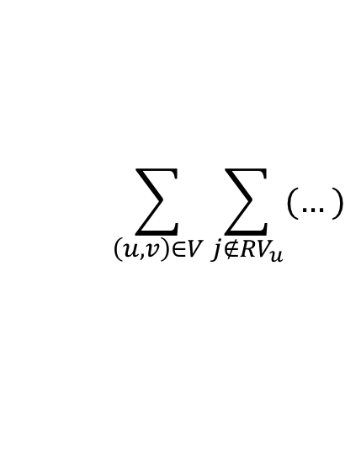
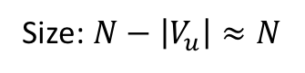
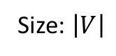
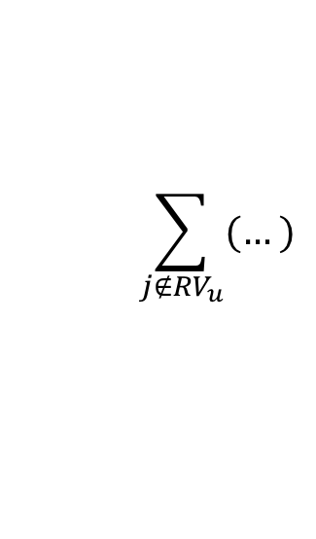
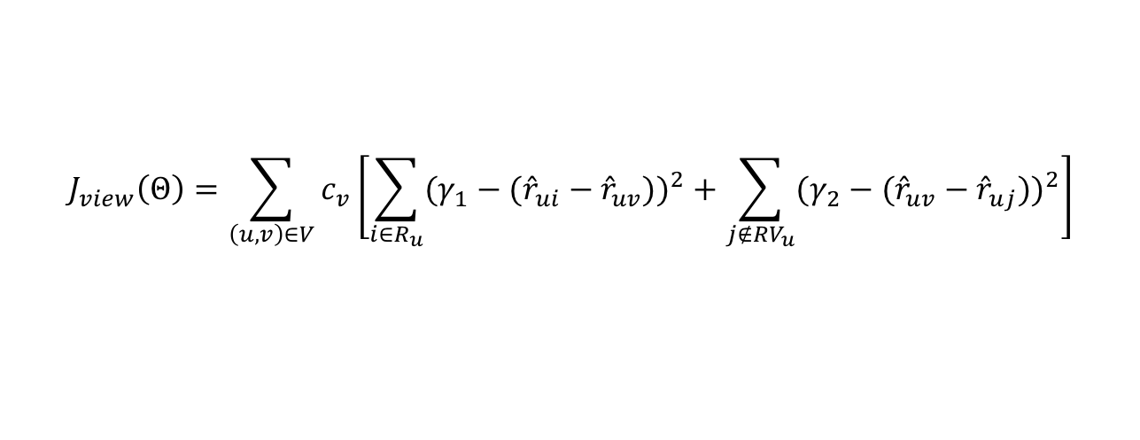
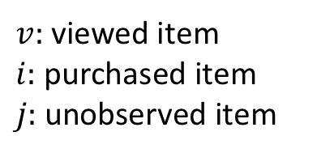
VALS – Efficiency Challenge
Infeasibility of the previous eALS learner
$J_{view}$ part introduces nearly $|V|∙N$ pairwise terms
$N$ times slower (N: # of items; |V|:# of view interactions)
Bottleneck:
summations over item pairs $\left(v,i\right)$ or $\left(v,j\right)$
missing data part
$$J_{view}\left(Θ\right)=\sum_{\left(u,v\right)∈V}{c_{v}}\left[\sum_{i∈R_{u}}{{(γ_{1}−({\hat{r}}_{ui}−{\hat{r}}_{uv}))}^{2}}+\sum_{j∉{RV}_{u}}{{(γ_{2}−({\hat{r}}_{uv}−{\hat{r}}_{uj}))}^{2}}\right]$$
Size: $\left|V\right|$
Size: $N−\left|V_{u}\right|≈N$
$$\sum_{\left(u,v\right)∈V}{\sum_{i{∈R}_{u}}{(…)}}$$
$v:$ viewed item
$i:$ purchased item
$j:$ unobserved item
$$\sum_{\left(u,v\right)∈V}{\sum_{j{∉RV}_{u}}{(…)}}$$
$$\sum_{j{∉RV}_{u}}{(…)}$$
unobserved interactions, neither purchased nor viewed

Slide 8
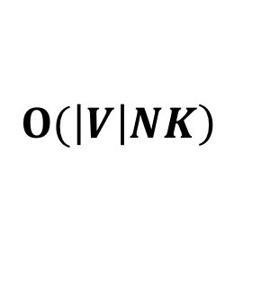
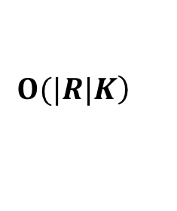
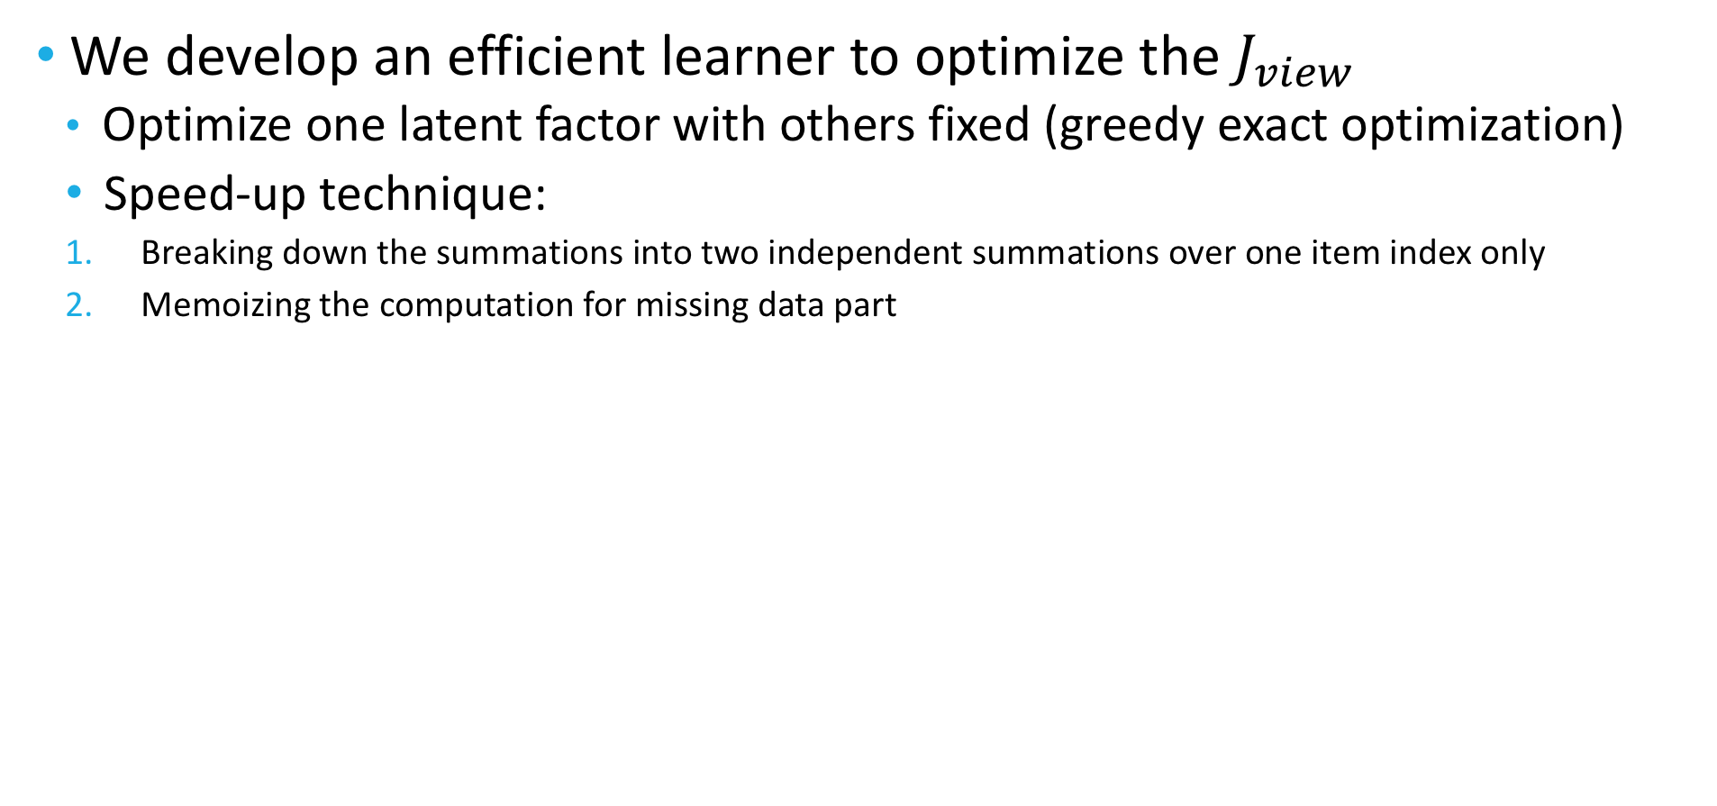
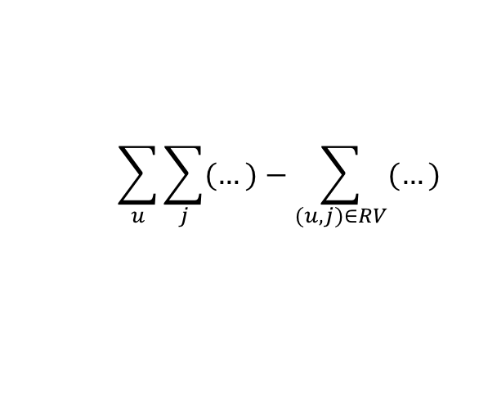
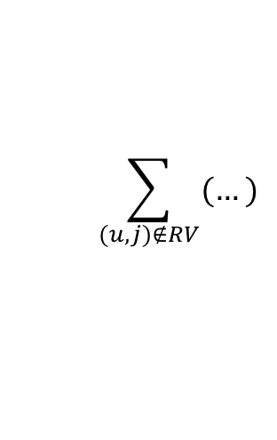
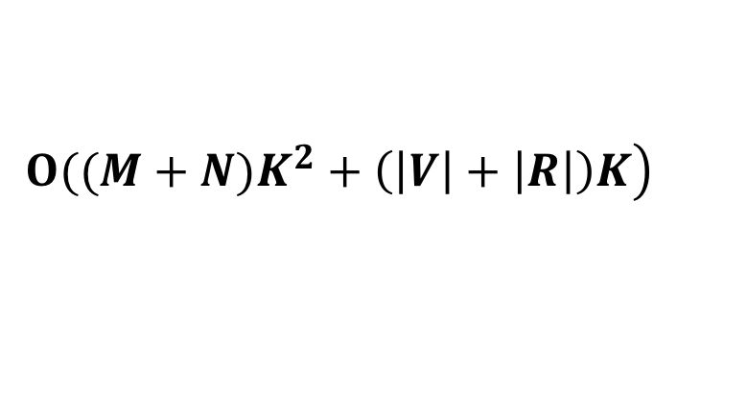
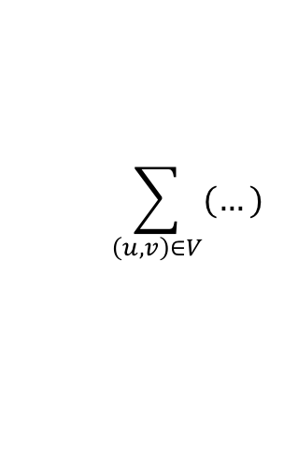
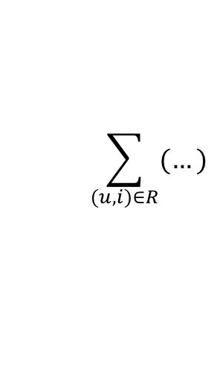
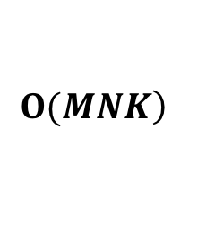
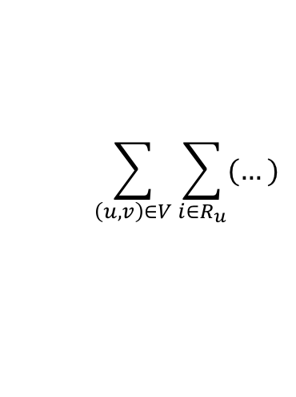
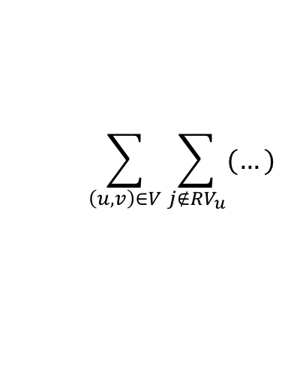
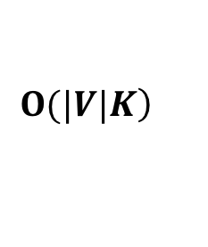
VALS – Efficient Learner
We develop an efficient learner to optimize the $J_{view}$
Optimize one latent factor with others fixed (greedy exact optimization)
Speed-up technique:
Breaking down the summations into two independent summations over one item index only
Memoizing the computation for missing data part
$$\left.Ο(\left|V\right|NK\right)$$
$$\left.Ο((M+N)K^{2}+\left(\left|V\right|+\left|R\right|\right)K\right)$$
$$\sum_{(u,i)∈R}{(…)}$$
$$\left.Ο(|R|K\right)$$
Linear to the observed data size (purchased + viewed interactions)
$$\sum_{\left(u,v\right)∈V}{\sum_{i{∈R}_{u}}{(…)}}$$
$$\sum_{\left(u,v\right)∈V}{(…)}$$
$$\left.Ο(|V|K\right)$$
$$\sum_{\left(u,v\right)∈V}{\sum_{j{∉RV}_{u}}{(…)}}$$
$$\sum_{(u,j)∉RV}{(…)}$$
$$\left.Ο(MNK\right)$$
$$\sum_{u}{\sum_{j}{(…)}}−\sum_{(u,j)∈RV}{(…)}$$
Algorithm details please see our paper.

Slide 9
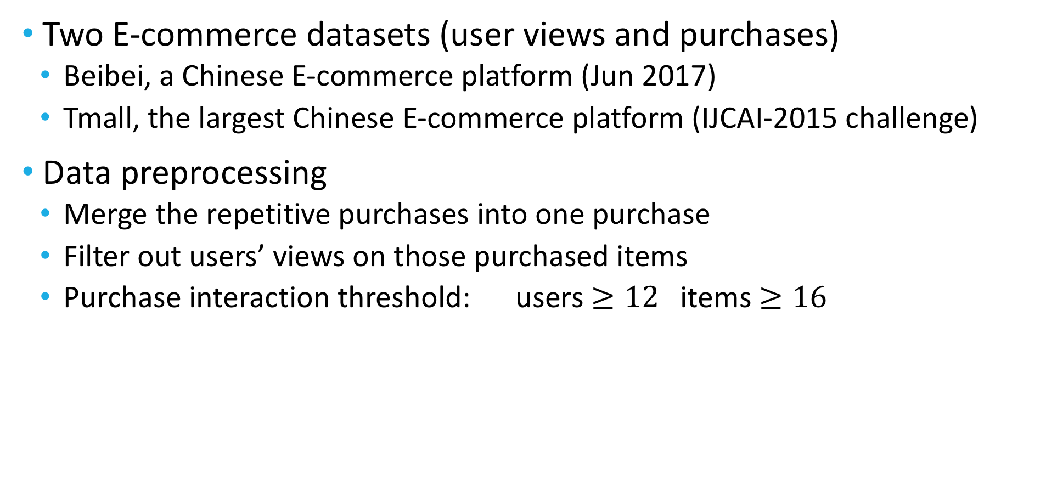
Dataset & Data Preprocessing
Two E-commerce datasets (user views and purchases)
Beibei, a Chinese E-commerce platform (Jun 2017)
Tmall, the largest Chinese E-commerce platform (IJCAI-2015 challenge)
Data preprocessing
Merge the repetitive purchases into one purchase
Filter out users’ views on those purchased items
Purchase interaction threshold: users $≥12$ items $≥16$
Dataset | Purchase# | View# | User# | Item# | Sparsity
Beibei | 2,654,467 | 23,668,454 | 158,907 | 119,012 | 99.99%/99.87%
Tmall | 352,768 | 1,585,225 | 28,059 | 32,339 | 99.96%/99.83%

Slide 10
Evaluation Methodology & Baselines
Evaluation
Leave-one-out evaluation: Hold out the latest interaction for each user as test (ground-truth)
Top-100 recommendation, metrics: Hit Ratio and NDCG
Parameters: # of factors=32 (others are also fairly tuned, see the paper)
Baselines
Purchase + View data
MR-BPR (Krohn-Grimberghe et al, WSDM’12)
collective matrix factorization technique, BPR
MC-BPR (Loni et al, RecSys’16)
predefined order when sampling training item pairs
MFPR (Liu et al, PAKDD’17)
Purchase data only
eALS (He et al, SIGIR’16)
whole missing data
BPR (Rendel et al, UAI’09)
sampled missing data

Slide 11
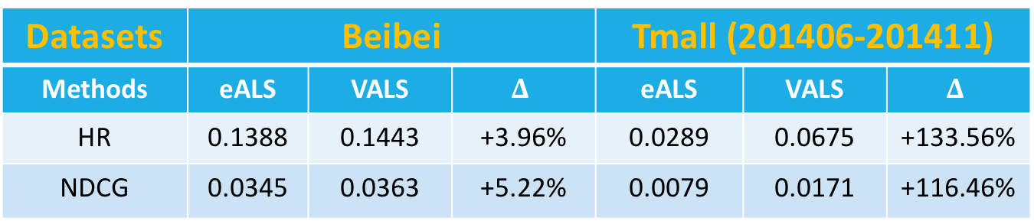
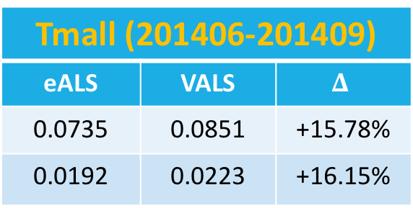
Performance Gain of View Data
Datasets | Beibei |  |  | Tmall (201406-201411)
Methods | eALS | VALS | $$Δ$$ | eALS | VALS | $$Δ$$
HR | 0.1388 | 0.1443 | +3.96% | 0.0289 | 0.0675 | +133.56%
NDCG | 0.0345 | 0.0363 | +5.22% | 0.0079 | 0.0171 | +116.46%
Users’ viewing behaviors provides valuable information
Effect of the Tmall Global Shopping Festival (2014.11.11) → a 100%+ improvement on Tmall (201406-201411)
Filter out data in Oct. and Nov.
Tmall (201406-201409)
eALS | VALS | $$Δ$$
0.0735 | 0.0851 | +15.78%
0.0192 | 0.0223 | +16.15%

Slide 12
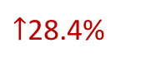
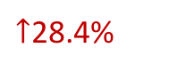
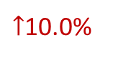
Compare with Baselines
$↑$10.0%
VALS achieves the best performance after convergence
pairwise ranking among purchase, view and other feedback
the whole-data based strategy of handling missing data
The best baseline is MC-BPR, which outperforms MR-BPR and MFPR
necessity of exploiting different preference levels between purchase and view data
$↑$28.4%
$↑$28.4%

Slide 13
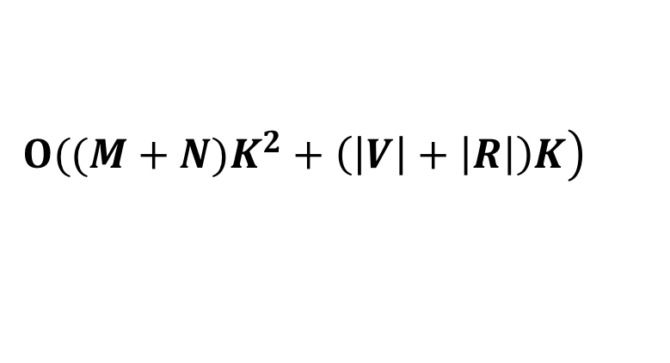
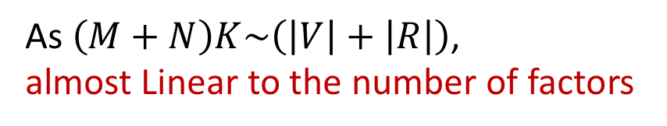
Efficiency Comparison
Training time per iteration (Java, single-thread)
 | Beibei (2.7M+23.7M)
Data size | VALS (K=32)
25% | 15s
50% | 35s
75% | 55s
100% | 75s
 | Beibei (2.7M+23.7M) | Tmall (0.36M+1.6M)
Factors K | VALS | VALS
16 | 47s | 2.7s
32 | 75s | 4.9s
64 | 149s | 10s
128 | 334s | 28s
Linear to the observed data size
As $\left(M+N\right)K\sim \left(\left|V\right|+\left|R\right|\right)$,
almost Linear to the number of factors
$$\left.Ο((M+N)K^{2}+\left(\left|V\right|+\left|R\right|\right)K\right)$$

Slide 14
Conclusion & Future Work
Summary of contributions:
A view-enhanced eALS (VALS) method that models user’s viewed interactions as an intermediate feedback
A fast learning algorithm which efﬁciently learns parameters from the whole data
Extensive experiments show both effectives and efficiency of VALS
Future Work
We will focus more on the ranking stage, integrating view data into generic feature-based models
We will apply VALS to other domains of implicit recommender systems, e.g., news, online videos and social networks

Slide 15
Thanks you! I’m happy to take questions.
Codes: https://github.com/dingjingtao/View_enhanced_ALS
dingjt15@mails.tsinghua.edu.cn
liyong07@tsinghua.edu.cn
FIB-LAB: http://fi.ee.Tsinghua.edu.cn

